Slide 1
5 Reasons To Choose Informatica PowerCenter As Your ETL Tool
View Informatica course details at www.edureka.co/informatica
For Queries:
Post on Twitter @edurekaIN: #askEdureka
Post on Facebook /edurekaIN
For more details please contact us:
US : 1800 275 9730 (toll free)
INDIA : +91 88808 62004
Email Us : sales@edureka.co
www.edureka.co/informatica

Slide 2
Objectives
At the end of this session, you will be able to understand:
Common Challenges in Data Integration
Informatica Overview
Reasons to Choose Informatica
High Availability and Recovery in Informatica

Slide 3



Common Challenges in Data Integration
Rising Complexity of Data
Increasing Business Demands
The Dirty Data
Cost Effective and High Standard Enterprise Data Integration

Slide 4
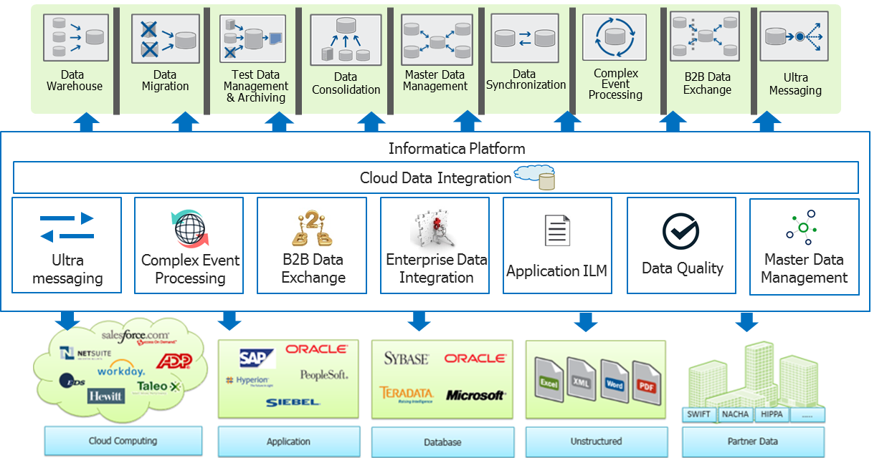
Solution: The Informatica Approach
Comprehensive, Unified, Open and Economical Approach
Notes:
4
4

Slide 5
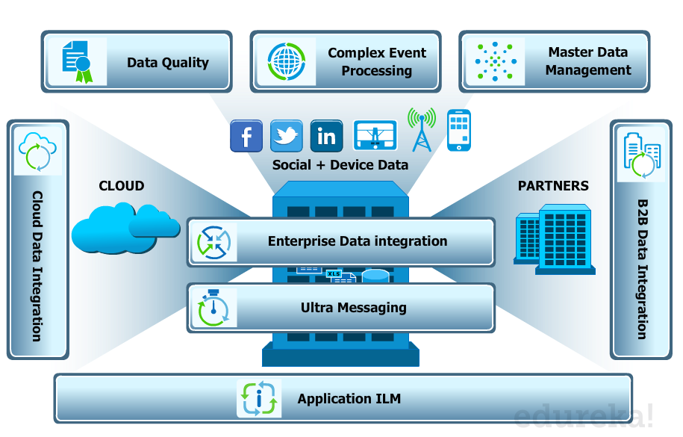
Informatica Products & Their Functionalities
Notes:
5
5
There are a wide range of Products available under the Informatica product suite that helps satisfy the data integration requirements within the enterprise and beyond
Informatica's product is a portfolio focused on Data Integration:
Data Integration & ETL
Information Lifecycle Management
Complex Event Processing
Data Masking
Data Quality
Data Replication
Data Virtualization
Master Data Management
Ultra Messaging
Currently at version 9.6, these components form a toolset for establishing and maintaining enterprise-wide data warehouses

Slide 6

Why Informatica?
Proven technology leadership
A track record of continuous innovation
The most neutral trusted partner
Long history of customer success
Near-100% “Go Live” success rate
94% Rate of renewal, significantly higher than the industry average of 86%*
92% Customer Loyalty rating, nearing world class levels
Unified, Open Model Based Architecture
A Singular Focus on Data Integration

Slide 7

Informatica 9.X Architecture
I S P
Analyst Service
Informatica
Analyst
Model
Repository
Service
Informatica
Developer
Repository
DO Cache
Data Integration Service
ODBC/JDBC Driver
Profile Service
Mapping Service
SQL Service
Runtime MRS
Admin
Console
Profile
Warehouse
Workflow Manager
Integration Service
Repository Service
Mapping Designer
Repository
Metadata Manager Service
Metadata
Manager
MM Warehouse
Notes:
7

Slide 8
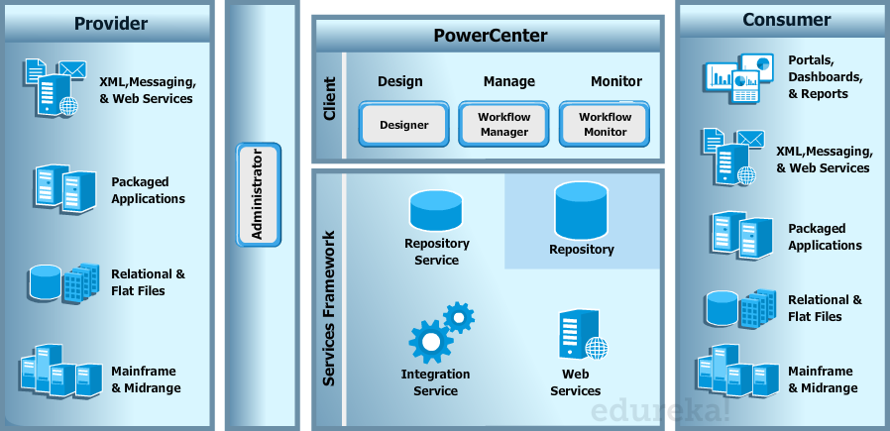
PowerCenter Architecture
Single Unified Architecture

Slide 9



Overall Architecture of PowerCenter
ODBC
DOMAIN
Native drivers/
ODBC
Native drivers/
ODBC
SOURCES
Integration
Service
Targets
TCP/IP
TCP/IP
Repository
Service
HTTPS
Administrator
ODBC
Repository
Service Process
TCP/IP
Security
Native drives
Native drives
Power Center Client
Domain
Metadata
Repository
Notes:
The figure above shows the overall architecture of PowerCenter 9.x.
As can be clearly seen in the figure above, the Domain is the centralized administration unit which consists of nodes to host the Integration and Repository services.
The PowerCenter client connects to the Domain -> Node -> Repository or Integration service through TCP/IP, while the Repository service interacts with the repository through native ODBC drivers to fetch the metadata information.
The data sources and targets are connected to the PowerCenter Client components and the Integration service through ODBC connections.
The Administration Console in PC 9.x is a web based application which connects to the domains and other services through HTTP for all admin activities.
A PowerCenter domain can be described as the fundamental administrative unit in PowerCenter. A domain is a logical collection or set of nodes and services.
A node on the other hand, is a logical representation of a physical machine. It has physical attributes such as hostname and port number. Each node runs a service Manager which is responsible for the application and core services. A node can be a gateway node or a worker node, but it can belong to only one domain.
For all the metadata transactions, the PowerCenter client applications first connect to the Repository services using TCP/IP which interacts with the Repository database through native drivers. While executing a workflow (or job) through the PowerCenter Workflow Manager or PowerCenter Workflow Monitor, the client application first connects to the Integration service.
Once connected, the Integration service retrieves mapping, workflow, and session metadata from the Repository through Repository service. It extracts data from the sources and stores the data in memory while it applies the transformation rules configured within the mapping. The Integration service then loads the transformed data into one or more targets.
The browser-based PowerCenter 9.x Administration Console is used to perform all administrative Task and it connects to the Repository service through HTTP.

Slide 10
Reason 1
Universal Data Access

Slide 11

Universal Data Access
Offers the broadest access to data, including near-universal access to all mainframe sources, including IMS, IDMS, Adabas, Datacom, VSAM files and IBM AS/400.
Complemented by Informatica PowerExchange® and the suite of PowerCenter Options
Structured, unstructured, and semi-structured data
Relational, mainframe, file, and standards-based data
NoSQL big data stores such as Hadoop HDFS
Message queue data
Notes:
Title and Content Slide – Font: Tahoma 12/14 (depending on the amount of text)
Heading: Calibri Heading 26 (consistent)
Bullet code – 174 for bullet
OOBB for sub bullet

Slide 12
Reason 2
Mission-Critical, Enterprise-Wide Data Integration

Slide 13
Mission-Critical, Enterprise-Wide Data Integration
Manages a broader range of data integration initiatives.
Meet enterprise demands for security, performance, scalability, collaboration, and governance through powerful capabilities as
High availability/failover/seamless recovery
Grid Computing Support
Pushdown optimization
Metadata management
Team-based development
Notes:
Title and Content Slide – Font: Tahoma 12/14 (depending on the amount of text)
Heading: Calibri Heading 26 (consistent)
Bullet code – 174 for bullet
OOBB for sub bullet

Slide 14
Mission-Critical, Enterprise-Wide Data Integration
Mission-Critical, Enterprise-Wide Data Integration:
Data masking
Data validation
Proactive Monitoring
In built scheduling tool
Notes:
Title and Content Slide – Font: Tahoma 12/14 (depending on the amount of text)
Heading: Calibri Heading 26 (consistent)
Bullet code – 174 for bullet
OOBB for sub bullet

Slide 15
High Availability Features
Failover
Automatic restart of PowerCenter services on same or another node
Primary and backup nodes
No fail-back to primary
Resilience
Automatic retry of failed connections within configured period
Clients and sessions resilient to
Network errors
DB connection failures
FTP connection failures
Recovery
Running workflow and sessions is automatically restarted/resumed
Checkpoints
HA License
Notes:
Title and Content Slide – Font: Tahoma 12/14 (depending on the amount of text)
Heading: Calibri Heading 26 (consistent)
Bullet code – 174 for bullet
OOBB for sub bullet

Slide 16
Reason 3
Cost Effective Scalability

Slide 17
Cost Effective Scalability
Interoperate across Organization’s entire existing infrastructure, including all hardware, software, operating systems and application servers
Partitioning
Parallel Execution of session
Workflow Concurrent execution
Integration service on grid
Session on Grid
Notes:
Title and Content Slide – Font: Tahoma 12/14 (depending on the amount of text)
Heading: Calibri Heading 26 (consistent)
Bullet code – 174 for bullet
OOBB for sub bullet

Slide 18
Parallel Job Execution
Achieve Parallelism using PowerCenter Partitioning Option
Process Massive Data Volumes with High Performance
Data Smart Parallelism
Guaranteed Data Integrity
Session Design Tools
Integrated Monitoring Console
Concurrent Workflow Execution
Workflows can be configured to execute concurrently
Notes:
Title and Content Slide – Font: Tahoma 12/14 (depending on the amount of text)
Heading: Calibri Heading 26 (consistent)
Bullet code – 174 for bullet
OOBB for sub bullet

Slide 19
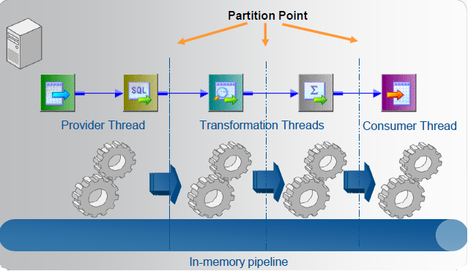
PowerCenter Architecture - Proven Scalability
Threaded Parallel Processing

Slide 20
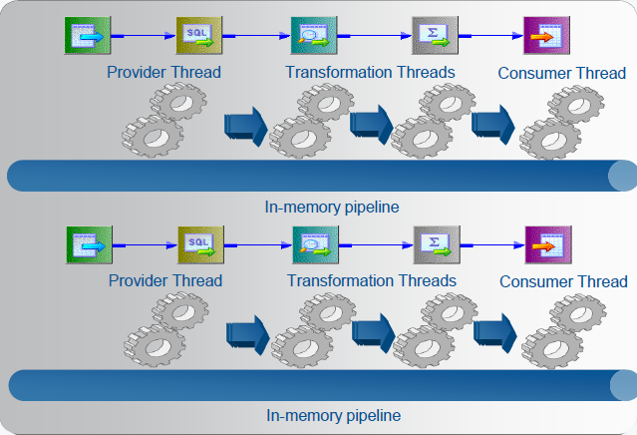
PowerCenter Architecture - Proven Scalability
Concurrent Processing

Slide 21
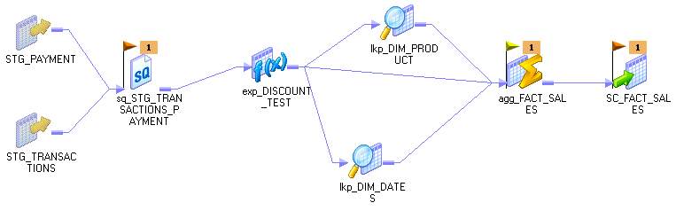
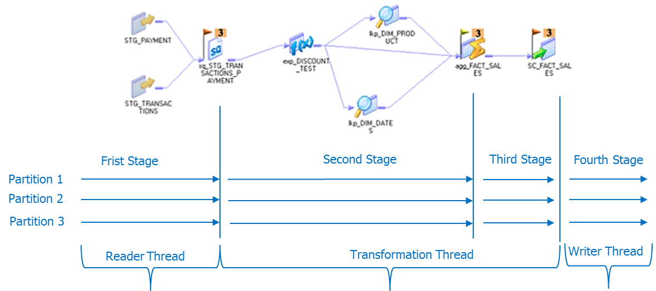
Threads, Partition Points and Stages
Threads are created to move data down the pipeline
The data is moved in pipeline stages defined by partition points. Stages run in parallel
By default PowerCenter assigns a partition point ( ) at the Source Qualifier, Target, and Aggregator transformations
Notes:
Title and Content Slide – Font: Tahoma 12/14 (depending on the amount of text)
Heading: Calibri Heading 26 (consistent)
Bullet code – 174 for bullet
OOBB for sub bullet

Slide 22
Partition Types
If you have >1 partition, each partition point specifies how the data will be distributed among the partitions
Valid partition types (color-coded flags in GUI)
Pass through (orange)
Key range (cyan)
Round robin (green)
Hash auto keys (yellow)
Hash user keys (blue)
Database (purple)
Dynamic Partitioning
Notes:
Title and Content Slide – Font: Tahoma 12/14 (depending on the amount of text)
Heading: Calibri Heading 26 (consistent)
Bullet code – 174 for bullet
OOBB for sub bullet

Slide 23
Cache Partitioning
Integration Service creates index and data caches for Aggregator, Rank, Joiner, Sorter, Lookup transformations
Partitioned session creates partitioned cache files
Partitioned cache will be created
For partitioned aggregator transformation
For joiner transformation if a partition point is created at the joiner transform
For lookup if hash auto key partition point is created at the lookup transform
For partitioned rank transformation
For partitioned sessions that create cache files
Configure root and cache directory to use a shared location for the integration service processes running the session.
If shared cache location is not configured, each service process on a node fetches data from the source to create a local cache.
If source data changes frequently, cache on the different nodes may be inconsistent
Notes:
For a session with multiple partitions, the Integration Service may use cache partitioning for the Aggregator, Joiner, Lookup, Rank, and Sorter transformations.
The Integration Service creates a separate cache for each partition and allocates the configured cache size to each partition.
The Integration Service stores different data in each cache, where each cache contains only the rows needed by that partition.
The Integration Service requires a portion of total cache memory for each partition.
Can configure memory requirements and cache directories for each transformation in the Transformations view on the Mapping tab of the session properties.
Memory requirements can be calculated by the total requirements for a transformation, and divide by the number of partitions.
To improve performance, configure separate directories for each partition.

Slide 24
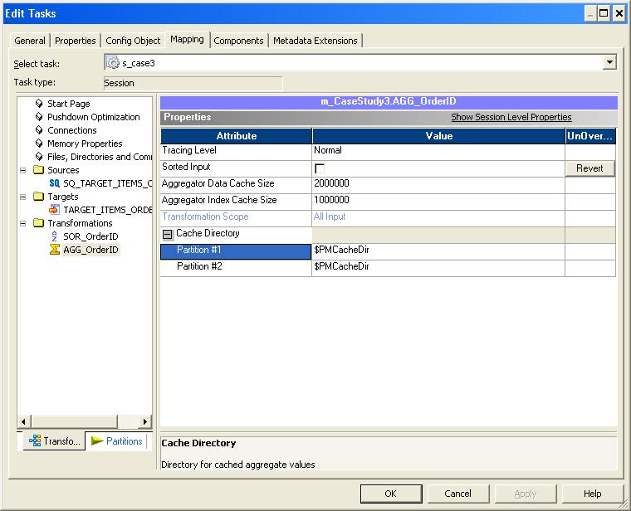
Cache Partitioning
Notes:
Title and Content Slide – Font: Tahoma 12/14 (depending on the amount of text)
Heading: Calibri Heading 26 (consistent)
Bullet code – 174 for bullet
OOBB for sub bullet

Slide 25
Concurrent Processing
Running session in Parallel
Concurrent Workflow Execution
Notes:
Title and Content Slide – Font: Tahoma 12/14 (depending on the amount of text)
Heading: Calibri Heading 26 (consistent)
Bullet code – 174 for bullet
OOBB for sub bullet

Slide 26
Grid Features
Grid Object
Configured from admin console
Grid consists of nodes
Nodes may belong to multiple grids
Grids may be a member of other grids
Services assigned to nodes or grid
Workflows are assigned to be run by services
Session on Grid
Can be configured to be executed on grid
Can partition sessions to run on multiple nodes
Dynamic Partitioning
# of partitions dynamically determined at runtime
Less configuration for users
Resource Map
Configure available resources on nodes in grid through admin console
Load balancer dispatch jobs based on resource availability on nodes
Notes:
Title and Content Slide – Font: Tahoma 12/14 (depending on the amount of text)
Heading: Calibri Heading 26 (consistent)
Bullet code – 174 for bullet
OOBB for sub bullet

Slide 27
Considerations for Workflow on Grid Usage
Use workflow on grid if:
There are many concurrent sessions and workflows
Leverage multiple machines in the environment
Requires heterogeneous platforms (e.g. SQL Server, 64 bit)
Use resource map to constrain where sessions are dispatched when:
Sessions in workflow depend on each other and there’s no shared storage (e.g. when sessions share cache or target of one session is used by another)
Required session resource is located on node where Master Integration Service process is running
Notes:
Title and Content Slide – Font: Tahoma 12/14 (depending on the amount of text)
Heading: Calibri Heading 26 (consistent)
Bullet code – 174 for bullet
OOBB for sub bullet

Slide 28
Session on Grid
Session partitioned and dispatched across multiple nodes
Allows Unlimited Scalability
Source and targets may be on different nodes
More suited for large sessions

Slide 29
Considerations for Session on Grid Usage
Smaller machines in a grid is a lower cost option than large multi-CPU machines
Session on Grid will scale if:
Sessions are CPU/memory intensive and overcomes overhead of data movement over network
I/O is kept localized to each node running the partition
There is a fast shared storage (e.g. NAS, clustered FS)
Source/target is not local to any node
Partitions are independent
Source and target have different connections that are only available on different machines
E.g. source Excel files on Windows and target is only available on UNIX

Slide 30
Dynamic Partitioning – How it Works
Reduce amount of specifications from user.
Make partitioning dynamic
# partitions determined at run-time
Partitions can be created based on # of nodes in grid
As # of nodes in grid increase/decrease, # of partitions adjusted accordingly
Partitions can be created based on source table partitioning
As data volume grows (data partitions increase) # of partitions also increase
Notes:
Title and Content Slide – Font: Tahoma 12/14 (depending on the amount of text)
Heading: Calibri Heading 26 (consistent)
Bullet code – 174 for bullet
OOBB for sub bullet

Slide 31
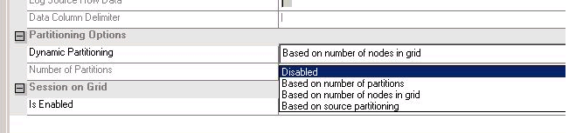
Dynamic Partitioning Options
Dynamic partitioning options
Based on user specification (# partitions)
Based on # of nodes in grid
Based on source partitioning (Database partitioning)
Oracle 9i, 10G
DB2 8.x
Notes:
Title and Content Slide – Font: Tahoma 12/14 (depending on the amount of text)
Heading: Calibri Heading 26 (consistent)
Bullet code – 174 for bullet
OOBB for sub bullet

Slide 32
Session on Grid and Dynamic Partitioning
Dynamic partitioning applies to both SonG and non-SonG sessions
If SonG is not enabled all partitions will run on single node
If SonG is enabled partitions will be dispatched to multiple nodes
Notes:
Title and Content Slide – Font: Tahoma 12/14 (depending on the amount of text)
Heading: Calibri Heading 26 (consistent)
Bullet code – 174 for bullet
OOBB for sub bullet

Slide 33
Dynamic Partitioning Limitations
Dynamic partitioning w/ range-based partitioning type
Doesn’t work for multiple field key ranges (will be fixed in GA)
Range must be closed (must specify min/max)
Only include data within min/max range (In GA, may have option for open range fields)
Assumes equal distribution of data across range
XML:
Not supported -- no N-way distribution of single source file or file lists yet
Can’t be used w/ debugger
Notes:
Title and Content Slide – Font: Tahoma 12/14 (depending on the amount of text)
Heading: Calibri Heading 26 (consistent)
Bullet code – 174 for bullet
OOBB for sub bullet

Slide 34
Reason 4
Meet Every Data Integration Need

Slide 35
Meet Every Data Integration Need
PowerCenter Standard Edition
PowerCenter Real Time Edition
PowerCenter Advanced Edition
PowerCenter Cloud Edition
Notes:
Title and Content Slide – Font: Tahoma 12/14 (depending on the amount of text)
Heading: Calibri Heading 26 (consistent)
Bullet code – 174 for bullet
OOBB for sub bullet

Slide 36
Reason 5
Collaboration between global IT teams

Slide 37
Collaboration between global IT teams
Flexible, metadata-driven architecture that standardize reusability across different levels
A set of robust visual tools to manage development and administration
Powerful productivity tools
Metadata management & Data Lineage
Notes:
Title and Content Slide – Font: Tahoma 12/14 (depending on the amount of text)
Heading: Calibri Heading 26 (consistent)
Bullet code – 174 for bullet
OOBB for sub bullet

Slide 38
Collaboration between global IT teams
Team-based development capabilities
Inbuilt Version control, no need for external version control tool
Check in, Check out, Version history
Control deployments across environments, locations, and teams to accelerate development using Deployment Group
Metadata management and Data Lineage
Consolidate technical and business metadata into one data integration catalog
Increasing insight into complex data relationships and trust in the data
Notes:
Title and Content Slide – Font: Tahoma 12/14 (depending on the amount of text)
Heading: Calibri Heading 26 (consistent)
Bullet code – 174 for bullet
OOBB for sub bullet

Slide 39
Scheduling Features in PowerCenter
In built Workflow scheduler to fulfil your scheduling needs
Can be configured with external scheduling tools like TWS, Autosys etc
Notes:
Title and Content Slide – Font: Tahoma 12/14 (depending on the amount of text)
Heading: Calibri Heading 26 (consistent)
Bullet code – 174 for bullet
OOBB for sub bullet

Slide 40
Reusability Features in PowerCenter
Purpose is to reduce unnecessary coding which ultimately reduces development time and increases supportability
Reusable Transformation
Mapplet
Worklet
Reusable Sessions & Tasks
Parameters & Variables
Shared Folder
Global Repository
Notes:
Title and Content Slide – Font: Tahoma 12/14 (depending on the amount of text)
Heading: Calibri Heading 26 (consistent)
Bullet code – 174 for bullet
OOBB for sub bullet

Slide 41
Recovery Overview
Recovery: Action of returning application/data/database to a normal and consistent state
Reason: OS / file system failure, network accessibility...
Recovery in PowerCenter
Data Recovery
Making inconsistent data consistent
Continuing workflows and tasks after they have been interrupted.
May be the result of an intentional stop
May be the result of a failure of a database, the network, or a server hosting a domain service.
Session recovery can be complex due to data issues
Domain infrastructure must be available
Repository Services and Integration Services (may be running as a backup service on another node).
Source, target, repository and lookup databases.
The network itself
Notes:
Title and Content Slide – Font: Tahoma 12/14 (depending on the amount of text)
Heading: Calibri Heading 26 (consistent)
Bullet code – 174 for bullet
OOBB for sub bullet

Slide 42
Enabling Recovery
An optional HA license is required for this check box to be available for selection.
Without the HA option, workflows must be recovered manually.
That is, you must locate the failed workflow in the Workflow Monitor client and manually tell PowerCenter to recover the workflow or use the command line to recover the workflow.
Recovery is turned on as
a workflow property
High Availability license key required to automatically recover workflows and tasks
Notes:
Title and Content Slide – Font: Tahoma 12/14 (depending on the amount of text)
Heading: Calibri Heading 26 (consistent)
Bullet code – 174 for bullet
OOBB for sub bullet

Slide 43
Workflow Recovery Overview
To recover a workflow ,the Integration Service should be able to access the workflow state of operation.
The workflow state of operation includes the status of tasks in the workflow and workflow variable values.
The Integration Service stores the state in memory or on disk, based on certain configurations:
Enable recovery. When a workflow is enabled for recovery, the Integration Service saves the workflow state of operation in a shared location. It can be recovered ,if it terminates, stops, or aborts. The workflow does not have to be running.
Suspend. When a workflow is configured to suspend on error, the Integration Service stores the workflow state of operation in memory. The suspended workflow can be recovered, if a task fails. After fixing the task error and recover the workflow.
Notes:
The Integration Service recovers tasks in the workflow based on the recovery strategy of the task. By default, the recovery strategy for Session and Command tasks is to fail the task and continue running the workflow. You can configure the recovery strategy for Session and Command tasks. The strategy for all other tasks is to restart the task.
When you have high availability, PowerCenter recovers a workflow automatically if a service process that is running the workflow fails over to a different node. You can configure a running workflow to recover a task automatically when the task terminates. PowerCenter also recovers a session and workflow after a database connection interruption.
When the Integration Service runs in safe mode, it stores the state of operation for workflows configured for recovery. If the workflow fails the Integration Service fails over to a backup node, the Integration Service does not automatically recover the workflow. You can manually recover the workflow if you have the appropriate privileges on the Integration Service.

Slide 44
Session & Tasks Recovery Overview
Recovery Strategy
Applies to Session and Command tasks
Determines what happens if the task fails
Used in conjunction with workflow recovery
Fail task and continue workflow (default)
Task status now “failed”
Restart task
Number of retries set on a workflow level (default is 5)
Resume from last checkpoint
Recovery data used to avoid writing target data that has already been committed to the database.
Notes:
The Integration Service recovers tasks in the workflow based on the recovery strategy of the task. By default, the recovery strategy for Session and Command tasks is to fail the task and continue running the workflow. You can configure the recovery strategy for Session and Command tasks. The strategy for all other tasks is to restart the task.
When you have high availability, PowerCenter recovers a workflow automatically if a service process that is running the workflow fails over to a different node. You can configure a running workflow to recover a task automatically when the task terminates. PowerCenter also recovers a session and workflow after a database connection interruption.
When the Integration Service runs in safe mode, it stores the state of operation for workflows configured for recovery. If the workflow fails the Integration Service fails over to a backup node, the Integration Service does not automatically recover the workflow. You can manually recover the workflow if you have the appropriate privileges on the Integration Service.

Slide 45
Recovering Manually
Done by hand (mouse/keyboard) or through a command-line script
Does not require a High Availability license key
Individual tasks within a workflow can be recovered separately
A suspended workflow can be resumed after the reason for the suspension is resolved.
A failed workflow can be recovered from any task within that workflow.
If needed and available, an Integration Service can be configured to run on a different node from within the
Administration Console.
Notes:
Title and Content Slide – Font: Tahoma 12/14 (depending on the amount of text)
Heading: Calibri Heading 26 (consistent)
Bullet code – 174 for bullet
OOBB for sub bullet

Slide 46
Cloud Data Integration
Informatica Cloud Edition
Informatica Cloud is an on-demand subscription service that provides data services.
When you subscribe to Informatica Cloud, you use a web browser to connect to the Informatica Cloud application.
Informatica Cloud Components
Informatica Cloud application
A browser-based application that runs at the Informatica Cloud hosting facility.
Configure connections, create users, and create, run, schedule, and monitor tasks.
Informatica Cloud hosting facility
A facility where the Informatica Cloud application runs.
The Informatica Cloud hosting facility stores all task and organization information.
Informatica Cloud does not store or stage source or target data.
Informatica Cloud Services
Services you can use to perform tasks, such as data synchronization, contact validation, and data replication.
Informatica Cloud Secure Agent
A component of Informatica Cloud installed on a local machine that runs all tasks and provides firewall access between the hosting facility and your organization.
Notes:
Title and Content Slide – Font: Tahoma 12/14 (depending on the amount of text)
Heading: Calibri Heading 26 (consistent)
Bullet code – 174 for bullet
OOBB for sub bullet

Slide 47
Survey
Your feedback is important to us, be it a compliment, a suggestion or a complaint. It helps us to make the course better! Please spare few minutes to take the survey after the webinar

